Slide 1
Ethereum Blockchain on Azure
Perth Cloud Meetup 10th October 2017

Slide 2
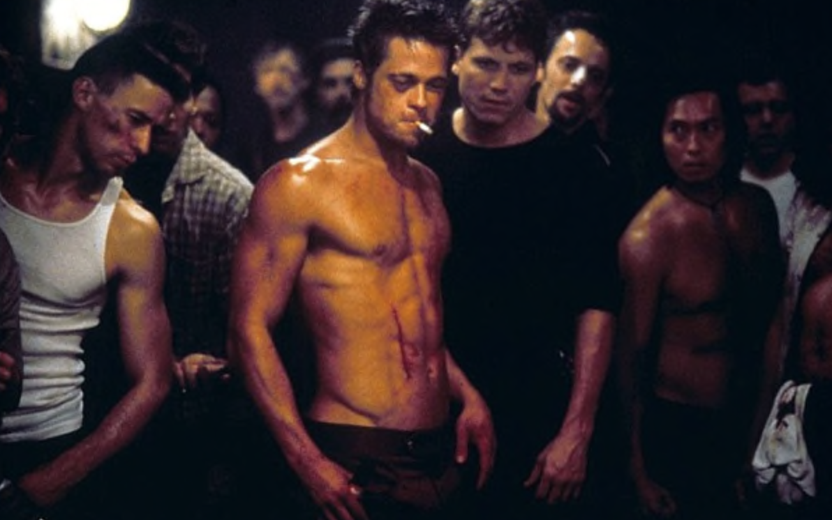
Rules of Blockchain Club!
Rule 1: Blockchain is not Bitcoin!
Rule 2: Blockchain is not Bitcoin!
Rule 3: Blockchain is all about trust in an untrusted environment.

Slide 3
Agenda
We’ll setup Azure
Well talk about how it all works
Discuss Smart Contracts and some real world examples
Demo of setting up account and sending “Eth”.
If we have time …
Deploy a Contract

Slide 4
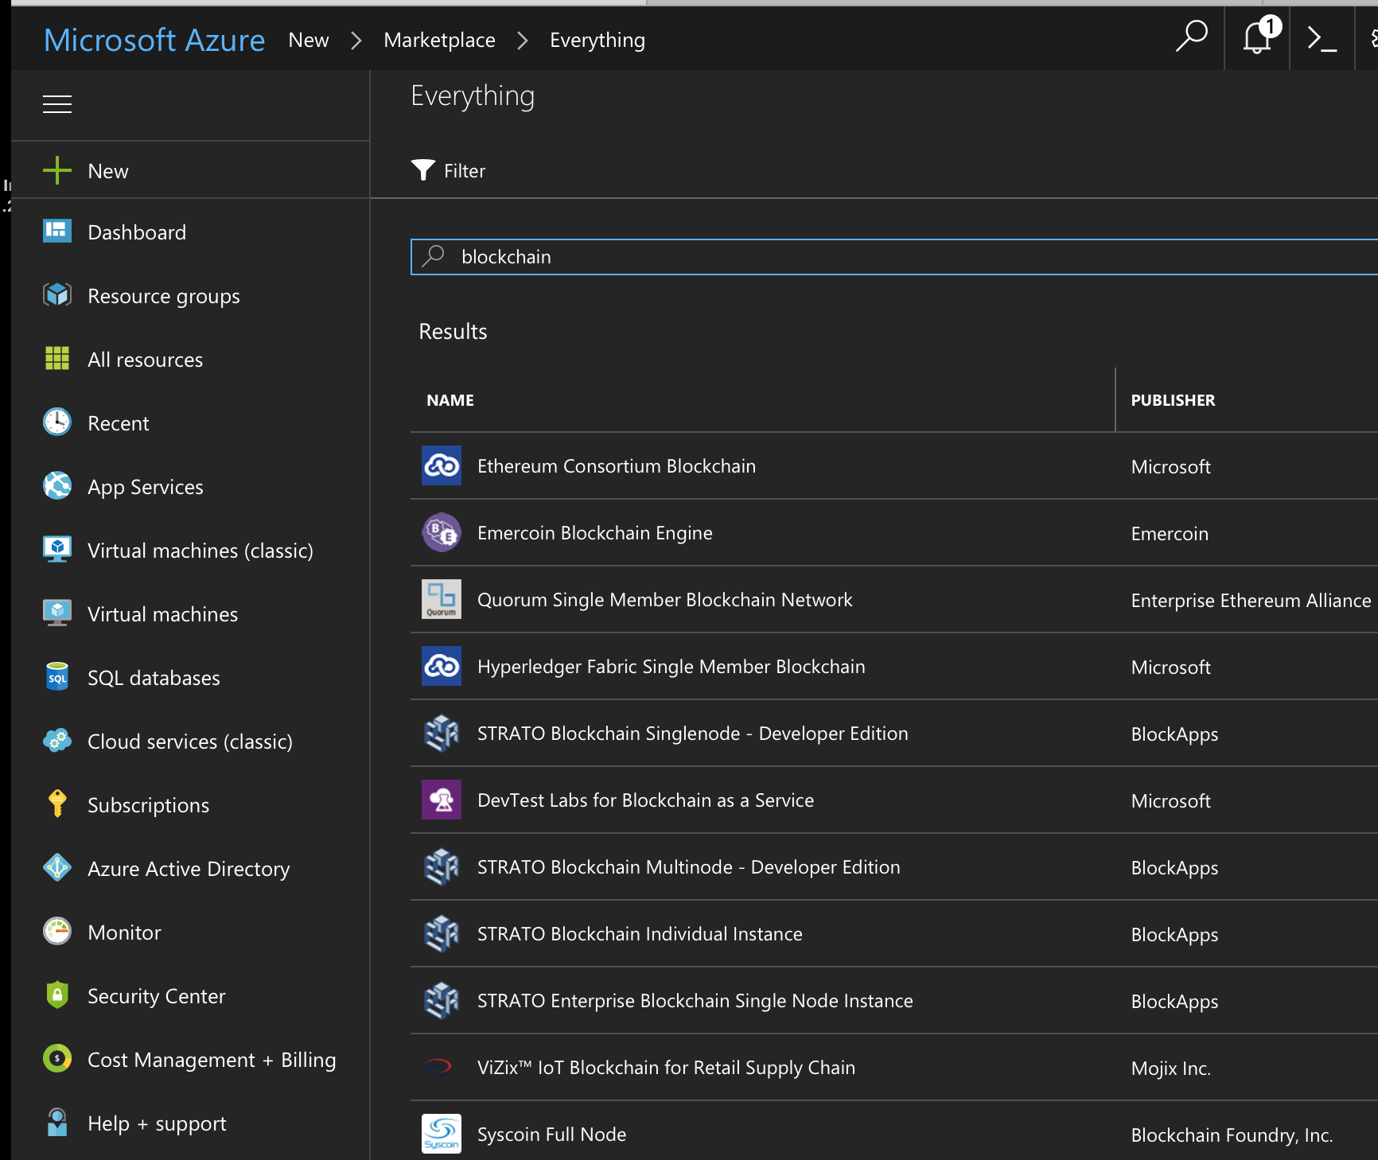
First up is the Azure Setup
Plenty of options in Azure
HyperLedger
Etheruem
Quorum
Stratro
Vizix
Syscoin
Emercoin
Just search “Blockchain”

Slide 5
What is a block chain? Some basics.
Distributed Database of processing nodes aka “Miners”
First record is called the “Genesis block”
Transactions are recorded in ‘Blocks’ by Miners
Every node (or majority) need to agree
Blocks are then cryptographically ‘signed’
Then it repeats
Blocks can’t be unchanged and incorruptible
Miner B
Miner A
Miner C
Miner D
Genesis block
######
Block
#2
######
Block
#3
######
Block
#4
######

Slide 6
But we’re also looking at Smart Contracts
Important
Your smart contract is NOT smart and NOT a contract! It’s just code that updates a ledger.
Your contracts are merciless and programmers make mistakes
Contracts run on every node in the network
Act as a automated “trusted” third party
Transfer tokens and pay out when a criteria has been reached
Trusted as code does not lie or cheat
Contracts can be published, checked and audited also “verified” to ensure what is supposed to happen, will happen.

Slide 7




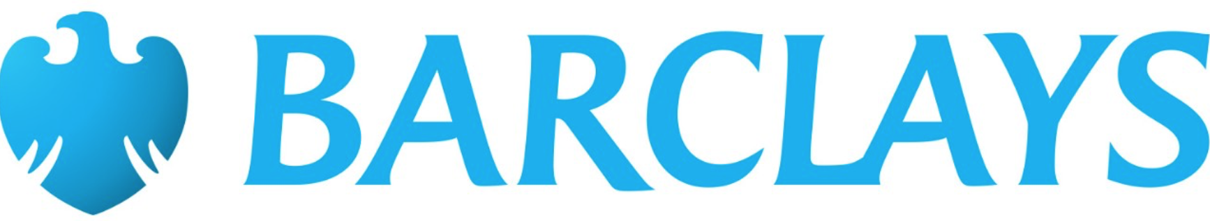



Some real world examples.
FINANCIAL / COMMERCIAL SERVICES
GOVERNMENT / CIVIL
The DAO
Various services
Shares
Diamond
tracking
Bill-of-lading
Food distribution
and Supply chain
Autonomous
Record Keeping
Swedish Land Registry

Slide 8
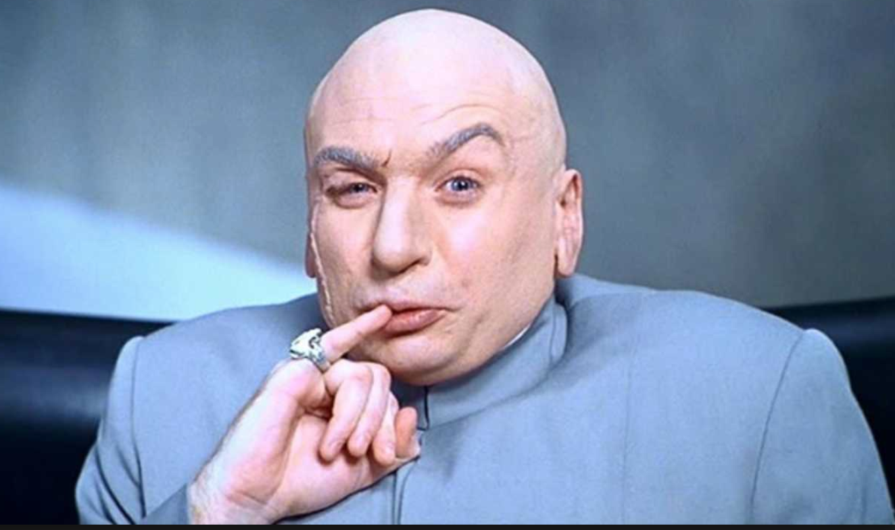
Demo
Lets start with 1 trillion Eth. !!!
Create a few accounts
Transfer Eth between accounts
Deploy a simple Contract
Interact with the contract

